Slide 1
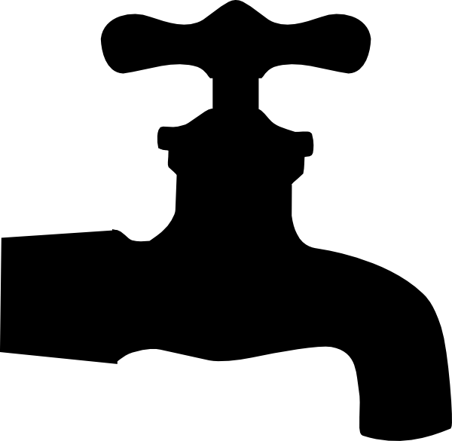
P peline
The Data
Machine Learning II: Training and Testing
© Jennifer Mankoff
The Data Pipeline; HCII; Spring 2014
Slides modified & borrowed from Carolyn Rosé
Want to go deeper? http://see.stanford.edu/see/lecturelist.aspx?coll=348ca38a-3a6d-4052-937d-cb017338d7b1

Slide 2
Evaluation

Slide 3
How can I tell if my classifier is any good?
Common measure: Accuracy
X% of the time, the recognizer was right

Slide 4
How can I tell if my classifier is any good?
Common measure: Accuracy
How many misclassifications of the training data
Typically not a good predictor for performance on new data

Slide 5
Holdout Validation
Hold back some of your training data to test against
Train classifier on subset without holdout
Test (accuracy) on holdout set
But need a large enough holdout set so you can trust the result (and this reduces your training data which you almost never have enough of)

Slide 6
How can I tell if my classifier is any good?
Better: K-fold Cross-validation
Break training data into K subsamples
K=10 very typical
For each subsample hold out that one and build a classifier with the remaining K-1 subsamples as training data
Test against holdout subsample; Average the results
Leave-one-out Cross-validation
K = size of the whole training data set

Slide 7
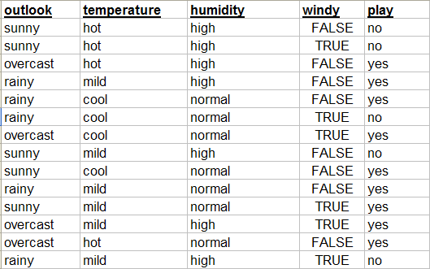

Slide 8
Train
Test

Slide 9
If Outlook = sunny, no
else if Outlook = overcast, yes
else if Outlook = rainy and Windy = TRUE, no
else yes
Performance on
training data?

Slide 10
If Outlook = sunny, no
else if Outlook = overcast, yes
else if Outlook = rainy and Windy = TRUE, no
else yes
Performance on
training data?
Performance on
testing data?

Slide 11
If Outlook = sunny, no
else if Outlook = overcast, yes
else if Outlook = rainy and Windy = TRUE, no
else yes
IMPORTANT!
If you evaluate the performance
of your rule on the same data
you trained on, you won’t
get an accurate estimate of
how well it will do on new data.

Slide 12
Simple Cross Validation
Fold: 1
TEST
1
Let’s say your data has attributes A, B, and C
You want to train a rule to predict D
First train on 2, 3, 4, 5, 6,7
and apply trained model to 1
The results is Accuracy1
TRAIN
2
TRAIN
3
TRAIN
4
TRAIN
5
TRAIN
6
TRAIN
7

Slide 13


Simple Cross Validation
Fold: 2
TRAIN
1
Let’s say your data has attributes A, B, and C
You want to train a rule to predict D
First train on 1, 3, 4, 5, 6,7
and apply trained model to 1
The results is Accuracy2
TEST
2
TRAIN
3
TRAIN
4
TRAIN
5
TRAIN
6
TRAIN
7

Slide 14
Simple Cross Validation
Fold: 3
TRAIN
1
Let’s say your data has attributes A, B, and C
You want to train a rule to predict D
First train on 1, 2, 4, 5, 6,7
and apply trained model to 1
The results is Accuracy3
TRAIN
2
TEST
3
TRAIN
4
TRAIN
5
TRAIN
6
TRAIN
7

Slide 15
Simple Cross Validation
Fold: 4
TRAIN
1
Let’s say your data has attributes A, B, and C
You want to train a rule to predict D
First train on 1, 2, 3, 5, 6,7
and apply trained model to 1
The results is Accuracy4
TRAIN
2
TRAIN
3
TEST
4
TRAIN
5
TRAIN
6
TRAIN
7
Notes:
And so on…

Slide 16
Simple Cross Validation
Fold: 4
TRAIN
1
Continue for all folds
Average the resulting accuracies
TRAIN
2
TRAIN
3
TEST
4
TRAIN
5
TRAIN
6
TRAIN
7
Notes:
And so on…

Slide 17
How can I tell if my classifier is any good?
How to select holdout subsample
Most commonly randomly selected partitions
“Stratified” → randomly choose partitions but in a way guaranteeing that each class is represented in approximately the right proportion
Stratified 10-fold cross-validation is most typical measure
But there are problems with this…
If the training data is not very independent
Multiple very similar (identical?) training instances
E.g., with temporal over sampling of sensors (i.e., values collected faster than sensors values typically change)
You will be back to testing against (a copy of part of) your training data
→ Estimates tend to end up too optimistic

Slide 18
How can I tell if my classifier is any good?
For HCI work you would often like to know: “If I give this classifier to a completely new user, how will it do?”
Argues for “per person” holdout (cross-validation)
Tends to give more realistic (less optimistic) estimates
But there can be issues with this which keep you from using it
Not enough different users and/or wildly variable amounts of data per users
Hard to compare results (5 users vs. 50 vs. can’t do it)
My recommendation: report both 10-fold random-holdout (stratified) cross-validation and per-person holdout cross-validation numbers (if you can reasonably do them)
10-fold random is quasi-standard and allows you to compare to all
Per-person is probably a better estimate

Slide 19
Remember!
If we are satisfied with the performance estimate we get using cross-validation
Then we build the model with the WHOLE SET
We don’t use cross-validation to build the model

Slide 20
Why do we do cross validation?
Use cross-validation when you do not have enough data to have completely independent train and test sets
We are trying to estimate what performance would you get if you trained over your whole set and applied that model to an independent set of the same size
We compute that estimate by averaging over folds

Slide 21
Do we have to do all of the folds?
Yes!
The test set on each fold is too small to give you an accurate estimate of performance alone
Variation across folds
Evaluation over part of the data is likely to be misleading

Slide 22
Why do we do cross validation?
Makes the most of your data – large portion used for training
Avoids testing on training data
Testing on training data will over estimate your performance!!!
But if you do multiple iterations of cross-validation, in some ways you are using insights from your testing data in building your model

Slide 23
Why do we do cross validation?
Do not have enough data to have completely independent train and test sets
Trying to estimate performance over your whole set
Makes the most of your data – large portion used for training

Slide 24
But then…..
If we are satisfied with the performance estimate we get
Then we build the model with the WHOLE SET
Now let’s see how it works…

Slide 25

But then…..
If you are not satisfied with the
performance you get,
then you should try to determine
what went wrong,
and then evaluate a different model
that compensates.
If we are satisfied with the performance estimate we get
Then we build the model with the WHOLE SET
Now let’s see how it works…

Slide 26
How can I tell if my classifier is any good?
How to select holdout subsample
Most commonly randomly selected partitions
“Stratified” → randomly choose partitions but in a way guaranteeing that each class is represented in approximately the right proportion
Stratified 10-fold cross-validation is most typical measure
But there are problems with this…
If the training data is not very independent
Multiple very similar (identical?) training instances
E.g., with temporal over sampling of sensors (i.e., values collected faster than sensors values typically change)
You will be back to testing against (a copy of part of) your training data
→ Estimates tend to end up too optimistic

Slide 27
How can I tell if my classifier is any good?
For HCI work you would often like to know: “If I give this classifier to a completely new user, how will it do?”
Argues for “per person” holdout (cross-validation)
Tends to give more realistic (less optimistic) estimates
But there can be issues with this which keep you from using it
Not enough different users and/or wildly variable amounts of data per users
Hard to compare results (5 users vs. 50 vs. can’t do it)
My recommendation: report both 10-fold random-holdout (stratified) cross-validation and per-person holdout cross-validation numbers (if you can reasonably do them)
10-fold random is quasi-standard and allows you to compare to all
Per-person is probably a better estimate

Slide 28
Feature Selection
Earlier indicated that feature selection is typically important to success
Very typical feature selection method: use information gain to “score” your features
Use the top N features ranked by information gain

Slide 29
Feature Selection
“Wrapper”-based feature selection
Combinatoric search / optimization through possible feature subsets using classifier accuracy as the objective function (this can be “wrapped” around any type of classifier)
Example (hill climbing):
Start with an empty set of selected features
Train a new classifier adding each candidate new feature
Keep the feature which produces the classifier with the best accuracy
Repeat until things stop improving
Can also start with all features and take away one at a time
More typical to do as simulated annealing rather than hill-climbing
This is an expensive process
Building and testing a classifier is “inside the loop” here so typically want a fast learner (e.g., naïve Bayes, decision trees)

Slide 30
What would happen if you do feature selection over your whole set of data prior to cross validation?

Slide 31
Overfitting!
Feature selection is part of model building
If you do feature selection over your whole set of data, including what you will test on, you have an unfair advantage
Your estimated performance will be overly optimistic!!
The same problem occurs if you design new features based on observations over your whole set of data.
Can you explain why?

Slide 32
Two Problems!!
At training time, if you include features that were designed based on the training data
Those features will perform better than they normally would
So your model will “trust them” too much
That will lead to poor model building
At testing time, if you have built a model using features you observed working well on your testing data
You have an unfair advantage
Normally those features wouldn’t show up with such a high predictive value
Double Whammy!!!

Slide 33
Correct Methodology
Set aside part of your data as a “development set” and create new features based on what you see in this set
Train on training data
Test on testing data (held out test set is most stringent)
Fine line: you should explore your data and get a sense of your data before model building – but don’t go so far as to induce features based on what you see

Slide 34
Software Tools
Weka (http://www.cs.waikato.ac.nz/ml/weka/)
Open source machine learning toolkit
Includes Java API
Data manipulation tools
Whatever you are comfortable with
Scripting language like Perl
Excel

Slide 35
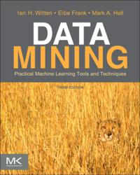
If you want to know more…
Witten, I. H., Frank, E., Hall, M. (2011). Data Mining: Practical Machine Learning Tools and Techniques, third edition, Elsevier: San Francisco

Slide 36
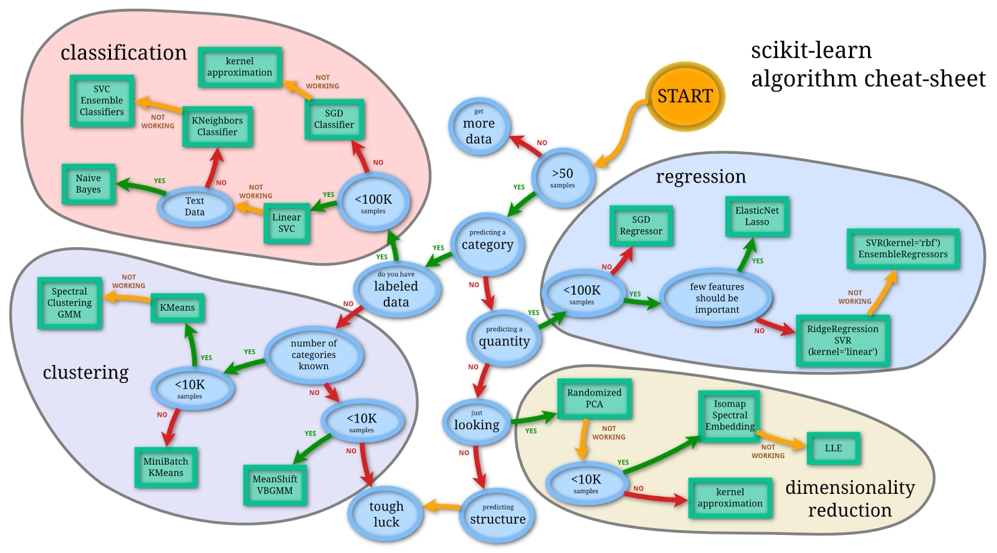
Selecting algorithms
http://www.quora.com/What-are-the-advantages-of-different-classification-algorithms

